Slide 1
Admission and Job Prediction System
Version 1.0
Developed by :
Phoenix Developers

Slide 2
Problem Statement
Prediction of Admission and Jobs in Engineering and Technology.
What are the skills or characteristics one should possessed so that one will be able to take admission in good colleges?
What are the various methodologies a college should adopt to improve its placement and in turn admissions?

Slide 3


Solution
So we have prepared two datasets which are as following:
1)datasetAdmission(ApplicantId,10thScore, 12thScore,JEEMains,PI(Personal Interview),Aptitude Score,Admitted or not)
2)datasetPlacement(CollegeId, No.OfStudents(Technical Stream), Current Trend, EnglishTrainingMonths, English, Quantitative Aptitude,NumberOfStudentPlaced)

Slide 4
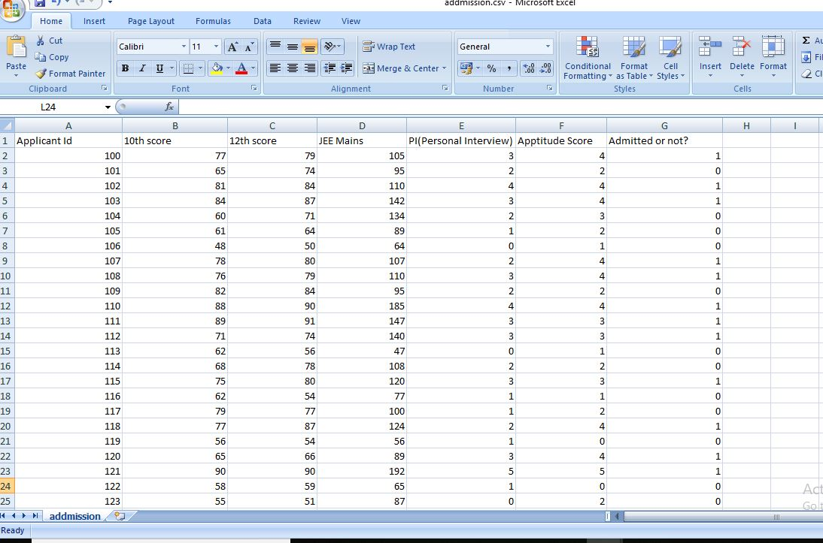
Our DataSet
datasetAdmission

Slide 5
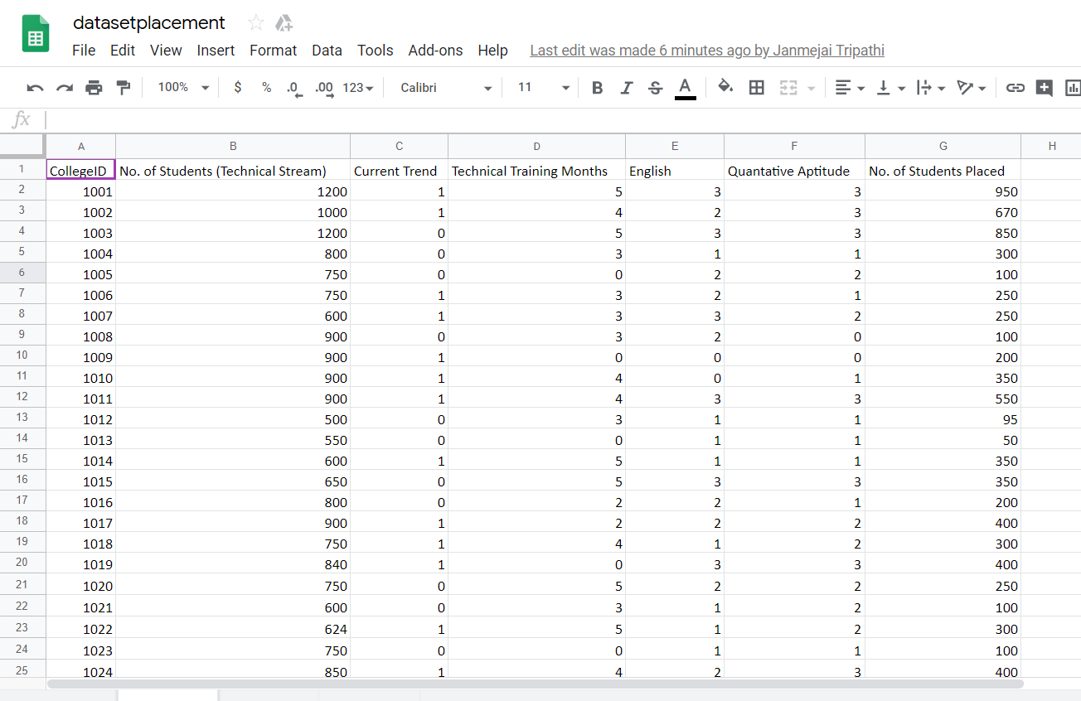
2. datasetPlacement

Slide 6
TOOLS & LIBRARIES
USED
TOOLS
JUPYTER
SPYDER
LIBRARIES
numpy
pandas
matplotlib
sklearn

Slide 7
Flow Of Code
Displayed Parameters
Import Libraries
(pandas, matplotlib)
Import Dataset
Application
LINEAR MODEL REGRESSION
Display of Result through graphs
Prediction
Train & Test our model
(sklearn)

Slide 8
Future Aspects
We can further make a web application or an android application to use this model efficiently.
On a big scale, we can collect verified data from surveys from colleges in different cities and make this model more effective and accurate.
Through this model, a college can identify the fields it can work upon to increase the placement records .
Also , a student can use this model to analyze whether he is eligible to get admitted in the particular college or not..

